Slide 1
DevOps - Development and Operations

Slide 2
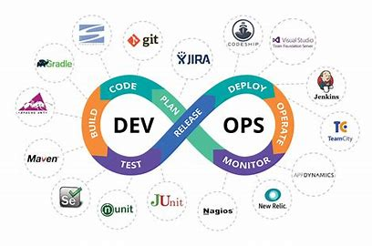
What is DevOps?
DevOps is a set of practices that combines software development ( Dev) and IT operations ( Ops ). It aims to shorten the systems development life cycle and provide continuous delivery with high software quality. DevOps is complementary with Agile software development; several DevOps aspects came from Agile methodology.

Slide 3
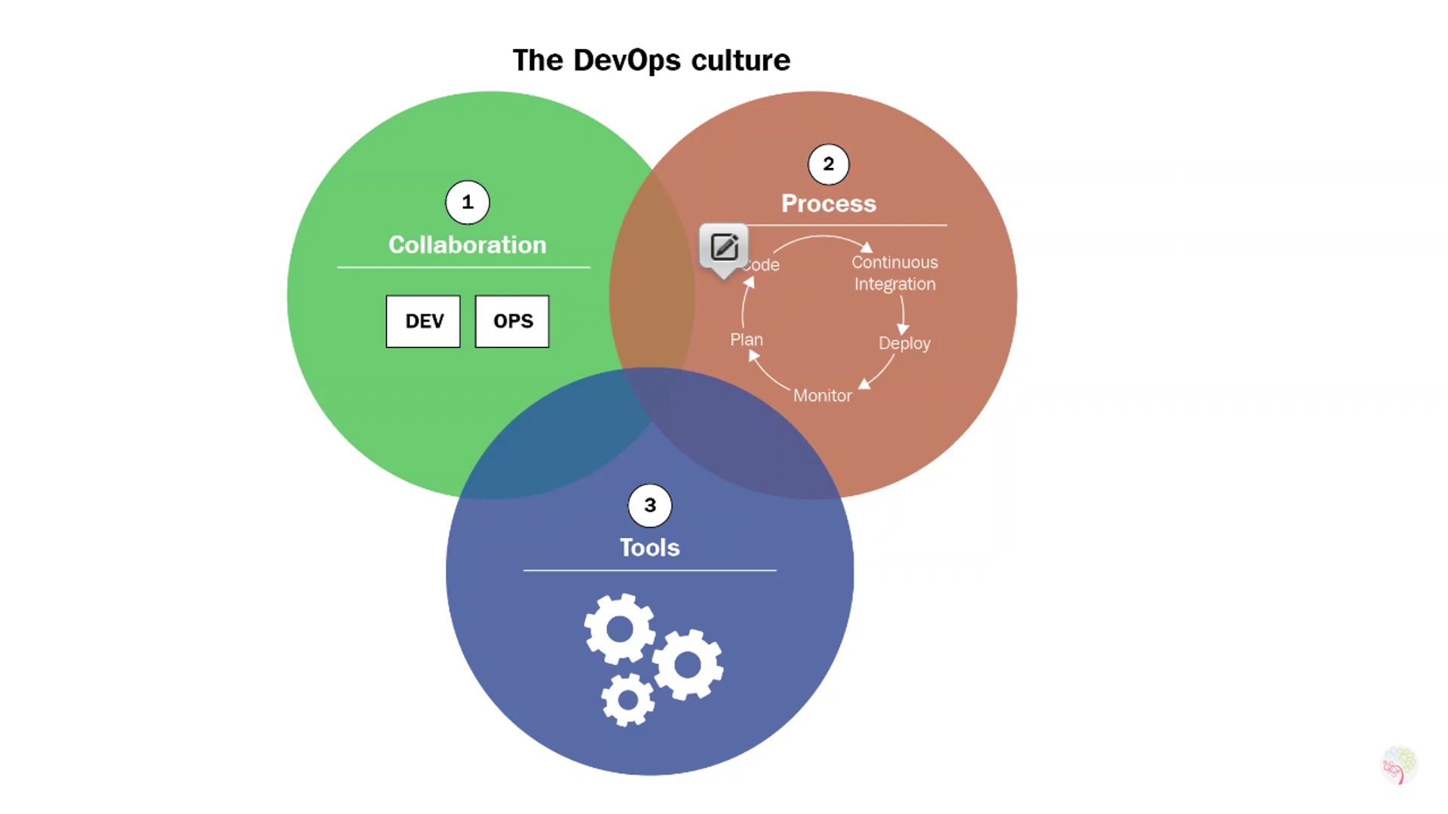
DevOps Culture

Slide 4
DevOps Benifits
Maximizes Efficiency with Automation
Optimizes the Entire Business
Improves Speed and Stability of Software Development and Deployment
It have take less time for Customer feedback
Challenges of DevOps
Choosing the Right Metrics is Hard
Limited funds
Complexity
Unrealistic goals

Slide 5
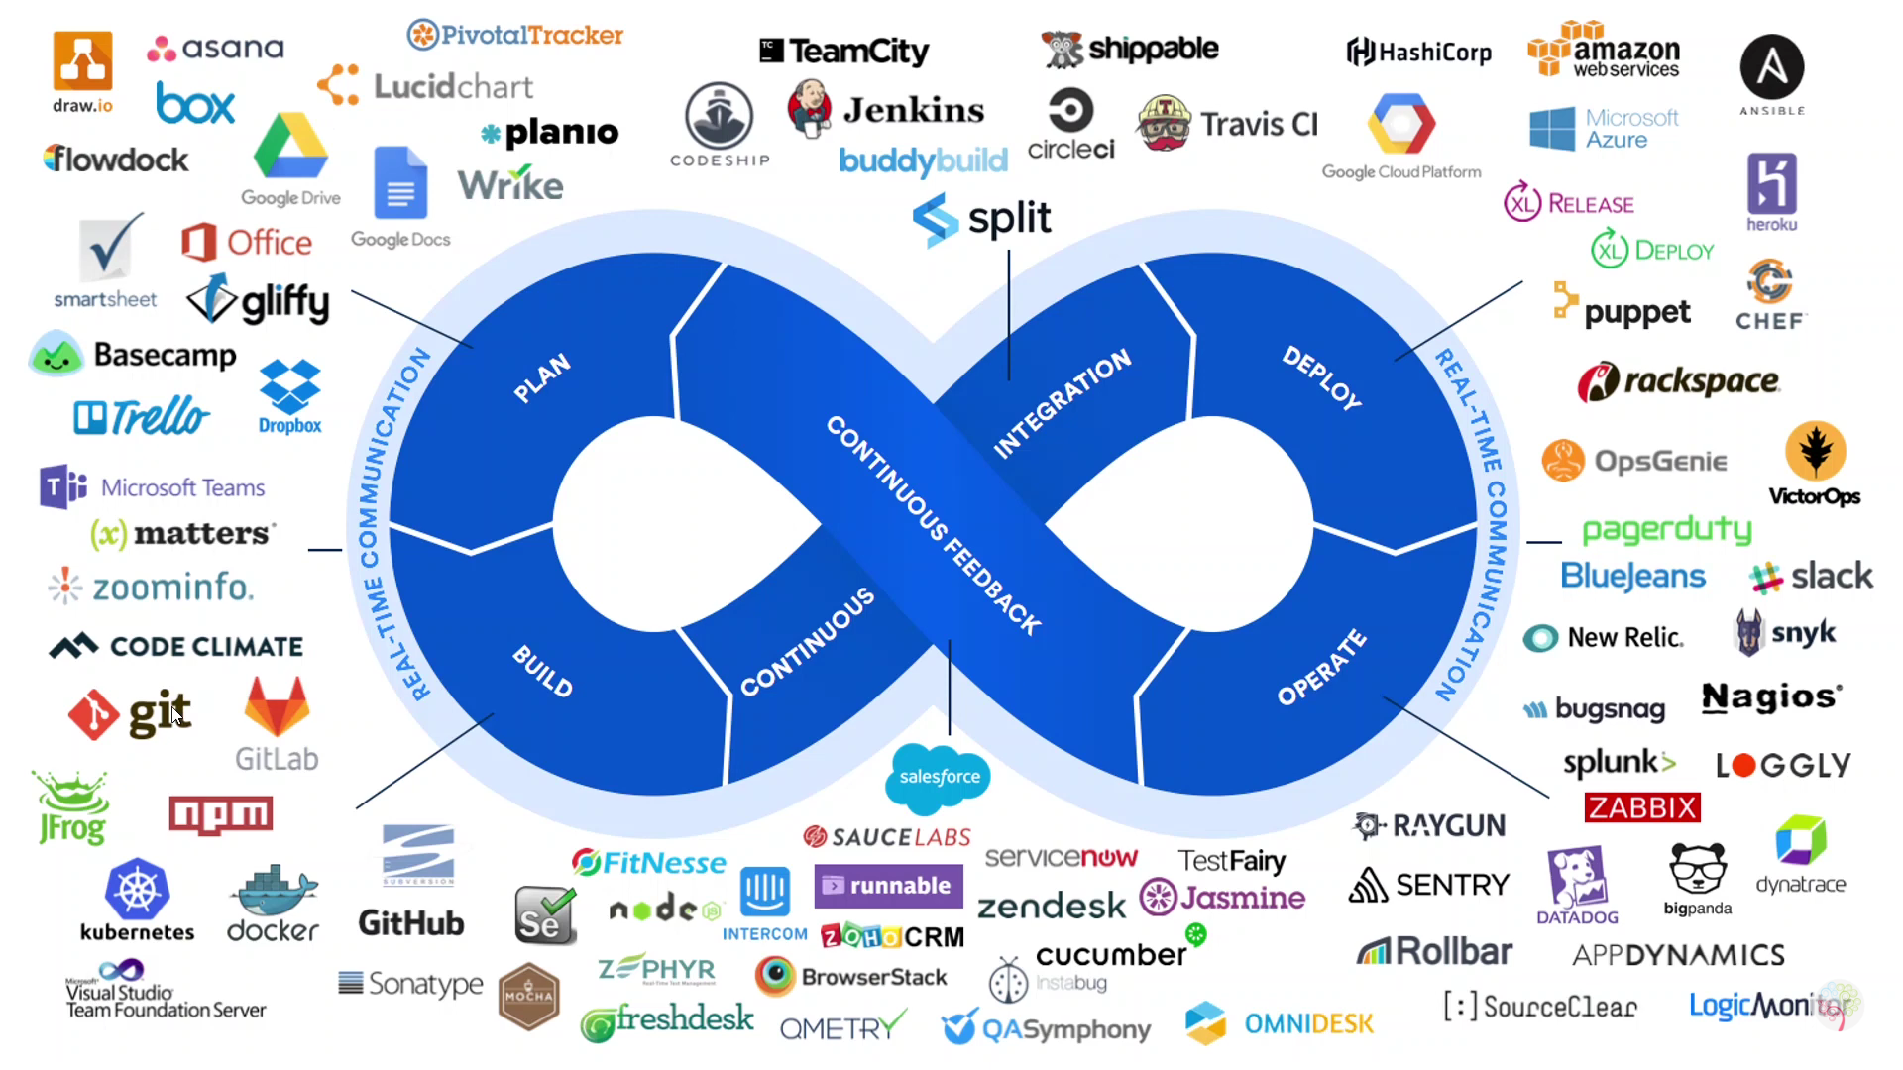
DevOps Tool

Slide 6
DevOps Practices
CI (Continuous Integration)
CD (Continuous Delivery)
CT (Continuous Testing)
CD (Continuous Deployment)

Slide 7
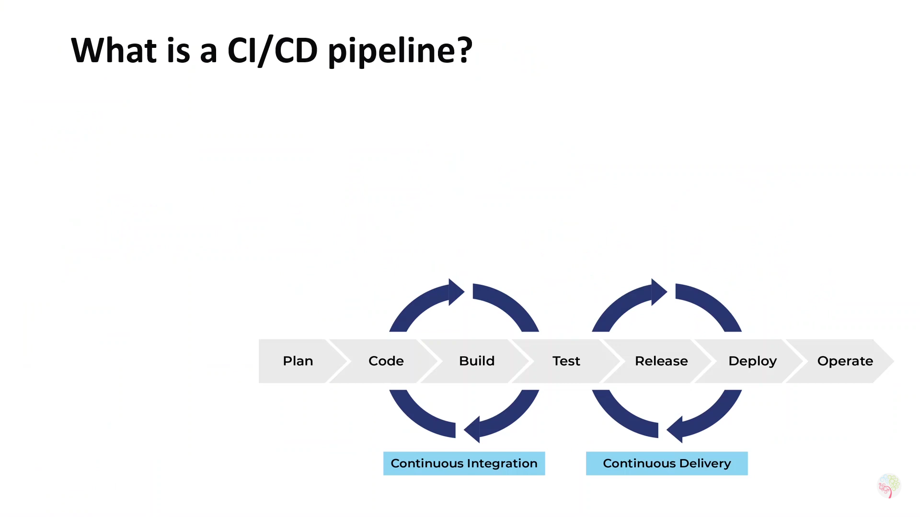

Slide 8
What is CI/CD Pipeline
CI/CD Pipeline helps you automate steps in your software delivery process, such as initiating code builds, running automated tests and testing deploying to a staging or production environment.
Automated pipeline remove manual errors, provide standardized development feedback loops and enable fast product iteration.
What is CI
Is a software development practice inn which all developer merge code changes in a central repository multiple times a day.

Slide 9
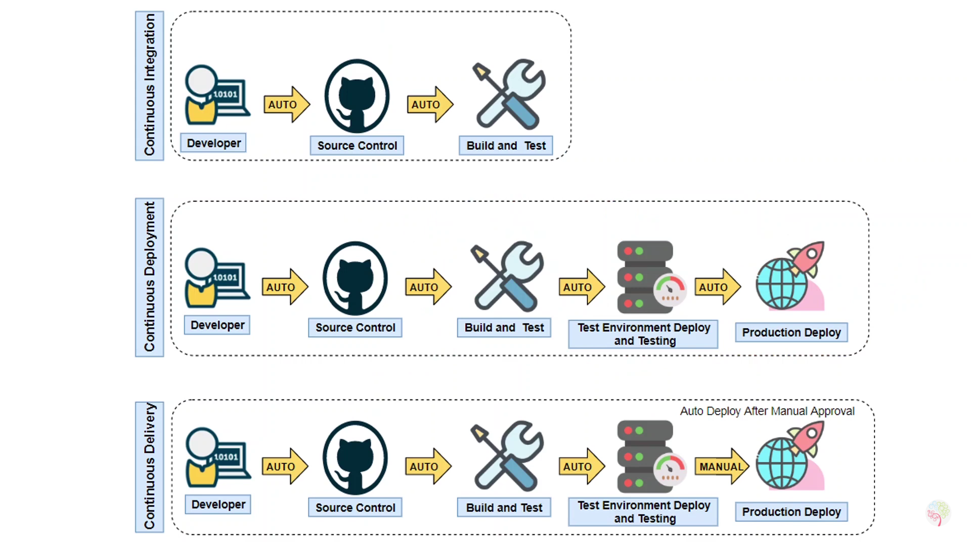
What is CD
Which on top of continuous integration adds the practice of automating the entire software release process.

Slide 10
Different Phases in Product Development
Design
Develop
Test
Integrate
Deliver
Requirement
Specification
Modelling

Slide 11
Development Methodologies
Waterfall
Agile
DevOps

Slide 12
Waterfall
A traditional software development methodology, whereby the project progresses through a predefined series of different stages before the work is considered complete.
Advantages
It uses a clear structure
The waterfall model determines the end goal early
It reinforces good testing habits
Disadvantage
The waterfall model doesn’t support making changes
It delays testing until after the completion of the project
The waterfall model can promote longer delivery times

Slide 13
Agile
An approach where the project is divided into various sprints lasting for 2-4 weeks. At the conclusion of each sprint, parts of the software can be released, even though the entire project may not be complete.
Advantage
Improved quality
Speed and flexibility
Cost control
Disadvantage
Less predictable
More time and commitment
Lack of necessary documentation

Slide 14
DevOps
Advantage
High speed
Fast delivery. Continuous delivery and integration contribute to fast delivery.
Collaboration. In general, the whole principle of DevOps is the cooperation of employees with each other.
Security
Disadvantage
Outsourcing DevOps operations reduced business security
Problems with the number of tools and switching between them.

Slide 15
Which Part of Embedded Can Use In DevOps
Firmware Development
Verification & Validation or Test/Integration
IoT Development

Slide 16
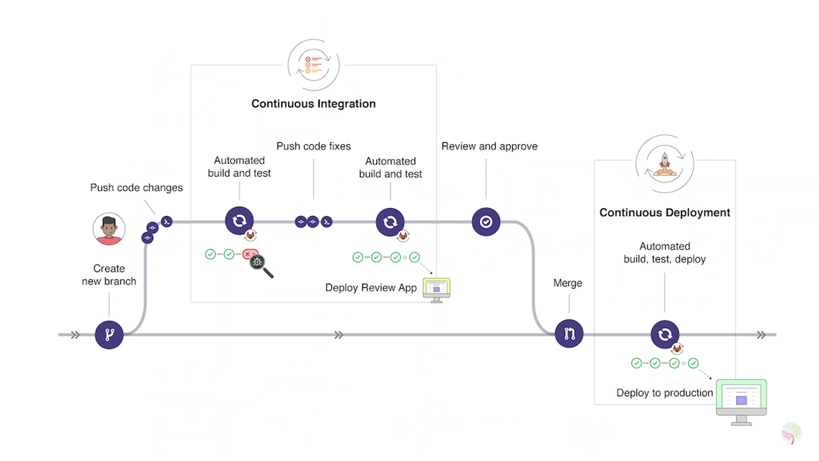
Process of DevOps

